Slide 1
Justice and Disaster Governance
Behnam Taebi, Delft University of Technology and Harvard University
3d International Symposium on Ethics of Environmental Health, Budweis, Czech Republic 28-31 August 2016

Slide 2
Technocratic approaches err
Technocratic approach to risk governance tend to neglect important social an ethical aspects of risk
  Those are approaches based on experts providing the facts upon which policy-making and the public should act
    (Van Asselt and Renn 2011; Kaliarnta, Hage and Roeser 2014)
Technocratic approaches to disaster governance suffer from the same deficiencies. They neglect
  Controversies regarding scientific knowledge as well as disagreements among experts
  Complexities of the scientific knowledge, including uncertainties; future forecast inherently involve uncertainties.
  Ethical issues involved in disaster governance: Justice

Slide 3
The aim and scope of presentation
The aim is to conceptualize disaster justice through the lens of good governance and ethics of risk (and energy justice)
Good disaster governance would at least require that we
  Respect criteria of good governance (accountability, participation)
  Explicitly acknowledge procedural and distributive justice issues
  Warrant the quality of information (for the sake of 1 & 2)
In stages of disaster mitigation, preparedness, response and recovery, there are three justice issues at play
  Namely distributive justice, recognition and procedural justice.

Slide 4
Particularity of radiation risk
The main focus of the presentation is on disasters involving radiological impact such as in Fukushima Daiichi
  The rationale of the argument is (hopefully) broadly applicable
Is the focus on radiation justified?
  Large uncertainties in health impacts (no safe level of radiation)
  Radiation risk is an accumulation of exposures
  It might manifest after a very long time (intergenerational issues)
  Major disasters with radiation have transnational consequences
I am also making references to the ongoing discussions within the International Commission on Radiological Protection (ICRP) on the ethics of radiological protection

Slide 5
Radiation exposure situations
Planned exposure situations, which are situations involving the planned introduction and operation of sources.
Emergency exposure situations, which are unexpected situations such as those that may occur during the operation of a planned situation, or from a malicious act, requiring urgent attention.
Existing exposure situations, which are exposure situations that already exist when a decision on control has to be taken, such as those caused by natural background radiation.
Planned and emergency exposure partly coincide the two stages of disaster mitigation and preparedness

Slide 6
Justice and radiation risk 1/2
Any activity involving radiation is proposed to bring benefit to some, but it also pose risk to some (other) people. This gives rise to distributional and procedural justice issues.
Consequentialism, deontology and principles of radiological protection
  The Principle of Justification: Any decision that alters the radiation exposure situation should do more good than harm.
  The Principle of Optimisation of Protection: The likelihood of incurring exposure, the number of people exposed, and the magnitude of their individual doses should all be kept as low as reasonably achievable, taking into account economic and societal factors.
  The Principle of Application of Dose Limits: The total dose to any individual from regulated sources […] should not exceed the appropriate limits specified by the Commission.

Slide 7
Justice and radiation risk 2/2
Similar to Energy Justice discussions - and building on Jenkins et al. (2016) - there are three justice issues at play
  Distributive justice issues as a result of an activity or siting a risky facility with local burdens and broader benefits; e.g. not only a nuclear power plant but also research reactor
  The issue of recognition, that is the question of who will be affected throughout the process of normal operation but also in case of irregularities or disasters: informed consent
  Procedural justice, or having a fair procedure for decision-making on the risky activity.

Slide 8
Disaster cycle and justice
Stage | How justice is relevant
Mitigation | It starts with recognition of different people who are exposed to different levels of risk. How are the vulnerabilities and resources to be distributed? How to decide which risks to reduce? ICRP Optimization Principles? Procedural issue: inclusiveness, genuine participation, due process, neutral arbitration, etc.
Preparedness | Very similar to the mitigation stage.
Response | Recognition and distributive justice are the relevant concepts. What justice principles must be guiding the response strategies? E.g. utilitarian and sufficientarian principles could contradict
Recovery | Again, it starts with the recognition of those affected. How are the resources to be distributed? How to decide on procedural issues?

Slide 9
Distributive justice challenges
What is the currency of justice?
  Vulnerability, resources, capabilities, basic goods
What is the shape of justice?
  Egalitarianism, utilitarianism, sufficientarianism, helping the least well off, etc.
Intergenerational justice

Slide 10
Fair stakeholders involvement 1/2
Already in 1999, the ICRP acknowledged that various exposure situations relate to human habitat “the Commission anticipates that the decision-making process will include the participation of relevant stakeholders rather than radiological protection specialists alone.” (ICRP 1999)
This view is reiterated in Publication 103 (ICRP 2007).
  Especially in the recovery stage, experiences from both major nuclear accidents, namely Chernobyl and Fukushima-Daiichi show that empowerment of affected people helps them to regain confidence, to understand the situation they are confronted with and finally to make informed decision to act accordingly (Lochard 2013).

Slide 11
Fair stakeholders involvement 2/2
  A more recent publications of the ICRP (2014) gives more explicit instruction for stakeholder involvement, for instance that “effective and meaningful” participation process would require the establishment of the guidelines at the beginning of the process; these guidelines should include “clear definition of the role of stakeholders at the beginning of the process; agreement on a plan for involvement; provision of a mechanism for documenting and responding to stakeholder involvement; and recognition, by operators and regulators, that stakeholder involvement can be complex and can require additional resources to implement.”
    ICRP Publication 124 (ICRP 2014; emphasis added)

Slide 12
Ethical issues of expertise and information
Information plays a crucial role for deciding in different stages of disaster governance (and for both distributive and procedural justice issues).
We must at least warrant the quality of information (transfer); i.e. transparency, credibility of and access to information etc.
  This is essential for the three justice notions at hand and for good governance of disasters

Slide 13
Complex & uncertain knowledge
Any future forecast inherently involves uncertainties
Uncertainties (and ignorance) are not issues that purely scientific approaches could respond to: normative dimension
  Who will be exposed to what and when could that happen?
Acknowledging uncertainties, ICRP recommends to uphold the value of prudence in radiological protection practices where decision-making is needed without full knowledge of the consequences
  This is similar to the Precautionary Principle

Slide 14
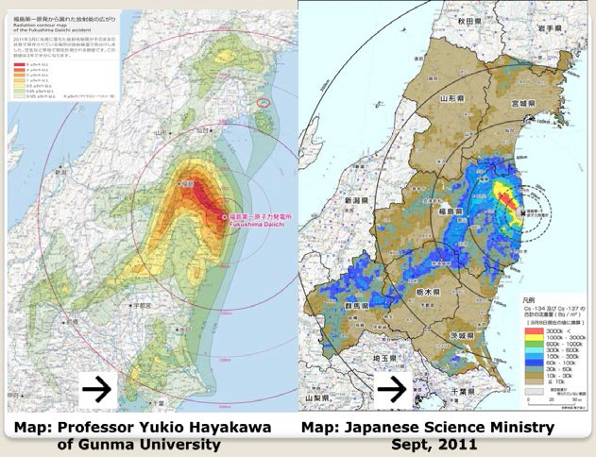
“Whose maps count?”
Adopted from “Living within an experimental space: Post-Fukushima imaginaries and practices of containing the nuclear”, a presentation by Ulrike Felt at Delft University, August 2015

Slide 15
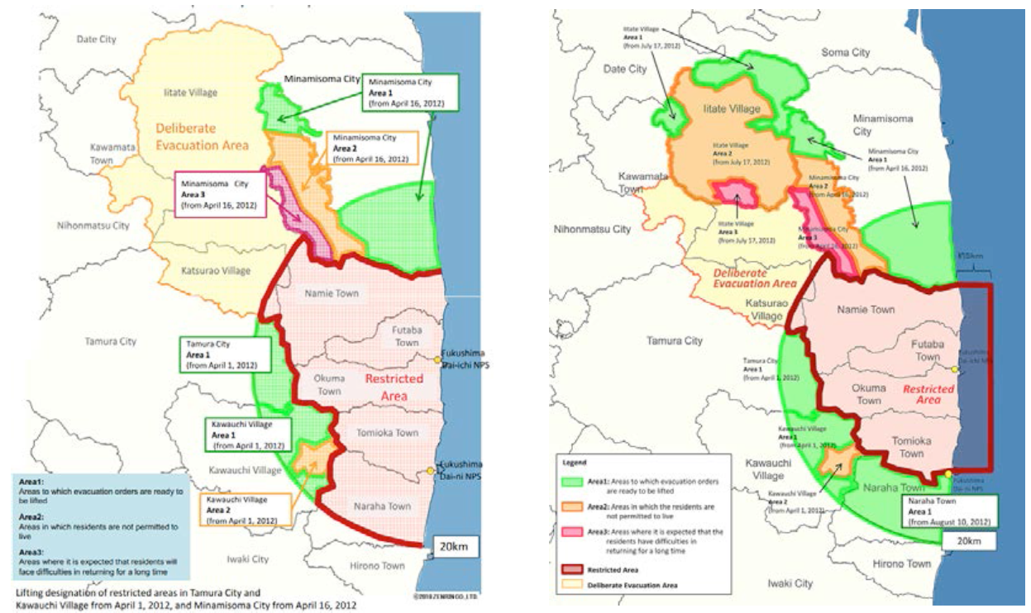
Redefining uninhabitable areas
Adopted from “Living within an experimental space: Post-Fukushima imaginaries and practices of containing the nuclear”, a presentation by Ulrike Felt at Delft University, August 2015

Slide 16
Quality of information 1/3
The quality of information
  Transparency
  Full disclosure of credible information
  Access to information
Similar to participatory approaches to risk governance, the questions of which knowledge and whose expertise should count are crucial aspects of disaster governance
What are the responsibilities of state(s), non-state actors (such as companies and NGOs) as well as supra-national actors in guaranteeing the quality of information in different pre- and post-disaster stages.

Slide 17
Quality of information 2/3
After the Fukushima disaster, information from Tepco, Japanese government, the IAEA, GreenPeace (immensely) contradicted
“A nuclear accident anywhere is a nuclear accident everywhere because of the traveling fallouts”
    Hans Blix, former IAEA Director General
This would plea for nuclear risk governance in international or multinational/regional setting. (Taebi and Mayer, n.d.)
  The problem of the IAEA with two mandates
  Would regional disaster governance better ensure the credibility and transparency of information?
  Would platforms such as ASEAN (Association of Southeast Asian Nations) be suitable for this?

Slide 18


Slide 19
Quality of information 3/3
What is the role of Citizen Science?
  The aim is to involve broad groups of citizens in decision-making (which is one of the primary goals of the good governance) but also aims to enable citizens to contribute to “collecting, categorizing, transcribing, or analyzing scientific data”
    (Bonney et al. 2014, 1436)
Can citizen science contribute to accountability?
  of the (local/national) governments and corporations by delivering more open-source data on controversial issues?
  There have already been some good experience with volunteers who used an Open source Network (called Safecast) to collect radiation data around the Fukushima-Daiichi crippled reactors.

Slide 20
Conclusion
The ambition of good disaster governance should be to provide a conceptual and normative framework to address justice issues and to deal with the complexity of knowledge and information
It could help to specify principles of and guidelines for Good Disaster Governance?
  What does accountability, responsiveness and participation entail in different stages of radiation disaster governance?
  What does distributive justice entail in radiation related issues? (e.g. acceptability of intergenerational risks)
  How to ensure the quality of information (transfer)?

Slide 21
Thank you for your attention
Comments are greatly appreciated
now or later through email:
B.Taebi@tudeft.nl

Slide 22
Disaster Management Cycle
I am following the four stages of disaster cycle, as defined by the Global Development Research Center; adopted from http://www.gdrc.org/uem/disasters/1-dm_cycle.html
  Mitigation - Minimizing the effects of disaster.
  Examples: building codes and zoning; vulnerability analyses; public education.
  Preparedness - Planning how to respond.
  Examples: preparedness plans; emergency exercises/training; warning systems.
  Response - Efforts to minimize the hazards created by a disaster.
  Examples: search and rescue; emergency relief .
  Recovery - Returning the community to normal.
  Examples: temporary housing; grants; medical care.

