Slide 1
Risk of Low (Radiation) Doses:
Precautionary Principle and Uncertainties¹⁾
Christian Streffer, University Clinics Essen, Essen, Germany
streffer.essen@t-online.de
¹⁾Partly based on: C. Streffer, H. Bolt, D. Follesdal, P. Hall, J.G. Hengstler, P. Jacob, D. Oughton, K. Prieß, E. Rehbinder und E. Swaton
Low Dose Exposures in the Environment – Dose-Effect Relations and Risk Evaluations, Springer-Verlag Berlin-Heidelberg-New York, 2004

Slide 2
In the modern world in which wealth and healthy life is highly dependent on efficient technologies and high standards of medical services as well as in areas with high human population densities it is necessary to achieve a balance between the development and the operation of efficient technologies on the one hand and the maintenance of a healthy and sustainable environment for today´s life and for future generations on the other hand.
Therefore regulatory processes for protecting humans and the environment including the setting of standards have to be performed under consideration of important principles of which some shall be discussed in the following.

Slide 3
Such a protection has to be done carefully without unduly limiting the mentioned desirable human actions. These challenges cannot be achieved without rational decision processes and should be based on:
Solid scientific data about the effects of ionizing radiation and of their mechanisms are essential,
Discussion of ethical and social implications including the uncertainties of the scientific evaluations, as well as a communication of risk and benefit under participation of concerned people in regulatory bodies and the public under conditions of transparency,
Procedures that promote rationality, provide legitimacy and ensure consistency with legal, especially constitutional, mandates and constraints.
What is the rational, scientific basis?

Slide 4
For the judgement of the toxicity of an agent the mechanism of its action should be known as well as possible and the information about the shape of the dose response is essential.
Critical assessments of the dose responses have to be based on solid epidemiological and experimental investigations.
In this connection, the knowledge about the shape of the dose response curves especially in the low dose range is very important.
Two dose responses are distinguished in toxicology and also for the action of ionizing radiation: A dose response with a threshold dose and a dose response without a threshold dose.

Slide 5
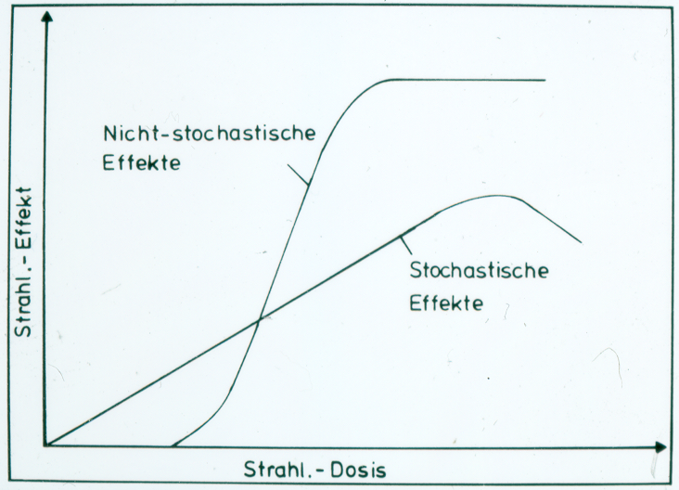
Assumed Possibilities of Dose-Effect-Relations for Exposures to Ionizing Radiation
Non-Stochastic Effects
(Various Types of Tissue Damages,
Including Death)
Stochastic Effects (Causation of Genetic Damage and Cancer)
100 mSv
a. higher

Slide 6
In the second case (no threshold) radiation effects (cancer, genetic effects) are expected even in low dose ranges.
By careful epidemiological studies with large populations a significant increase of cancer is observed after radiation exposures with doses above 100 mSv. Below this dose range the risk can only be extrapolated from high to low doses.
From a number of studies it is concluded that a linear dose response with no threshold is the best fit for the data. ICRP states it is prudent to use the LNT model for radiological protection. It is „the best practical approach to managing risk from radiation exposure and commensurate with the `precautionary principle´” (ICRP, 2007).
However, the data below 100 mSv have a high degree of uncertainty. No definite proof exists for the response in this dose range.

Slide 7
Solid Cancer, Incidence in Hir.+Nagas. (BEIR 2005)

Slide 8
Dose-Effect-Relation for Leukemia Risk, Population at the Techa-River after Exposure to radioactive Contamination (Krestinina, 2010)

Slide 9
All Solid Cancers Fitted Linear Dose Response and Dose Category Specific ERR Estimates in Hiroshima and Nagasaki (RERF 2008).
Challenge for biological res.
?
100 mSv
http://www.rerf.or.jp/

Slide 10
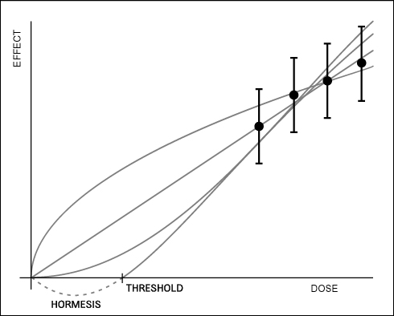
Possibilities of Extrapolation into the lower Dose Range
LNT is strongly disputed: Modifications by Mechanisms of „New Biology“ may be possible.
Supralinear
Linear
?
Linear-quadratic

Slide 11
.
Deviation of Cancer Mort. from the Average (‰) in 1996-2005 (SEER-U.S.A.) and Radiation Effect (ICRP)
‰ Deviation from Average
-------------------------------year-------
Radiat. Dose
The radiation effect <100 mSv is covered within the „noise“ of the „spontaneous“ cancers.

Slide 12
The annual dose limit for workers is 20 mSv in almost all countries worldwide.
In Germany around 98 % of radiation workers received a dose below 1 mSv in 2012. This situation is due to very efficient optimization in context with the system of dose constraints.
For members of the public the annual dose limit is 1 mSv.
A possible cancer risk for these people can only be estimated by extrapolation from exposures to doses higher than 100 mSv using the LNT model which then leads to a risk value of 10⁻³ with a dose of 20 mSv and of 5∙10⁻⁵ with a dose of 1 mSv with respect to stochastic effects, mainly cancer. These risk estimates again have large uncertainties.
On the other hand it is possible to measure and estimate radiation doses almost exactly even in the low dose range.

Slide 13
It is generally assumed that the LNT model implies an overestimate of risk and this is taken into account in context with the `precautionary principle´.
Is such an assumption justified? There are no data available with humans to support this. However, a number of animal data have been reported which are in favor of these assumptions as well as experimental data about DNA-repair and chromosomal aberrations support such a possibility.
However, it must be admitted that there exists disagreement about this judgement between competent scientists.
When the precautionary principle is discussed and evaluated it is not justified to take every imaginable scenario into consideration. Only theories with scientific plausibility should be taken seriously.

Slide 14
Further questions: Is the possible risk in the range of 1 to 20 mSv acceptable? How to deal with the uncertainties in the low dose range where the risk cannot be reasonably estimated?
The setting of limits for such risks is not only a matter of scientific data with probabilities and a degree of uncertainties. Acceptability is a normative notion with factors having to deal with a number of values including human autonomy with freedom, responsibility and dignity.
Some important considerations to acceptability are the following: Are people free to decide themselves whether they shall be exposed to the risk? What is the benefit which these people may have in this context?
Informed consent is necessary to anybody before an exposure to a serious risk takes place. Information is imperative about the type of risk as well as its quantitative degree.

Slide 15
The distribution of burdens and benefits among a group of people is highly important for the acceptability of the expected risk. This becomes highly problematic when those who are exposed are different from those who benefit.
Compensation may sometimes help to balance inequities. Inequity of exposures should be avoided as much as possible.
A high degree of transparency is necessary in the process of decision making on risk assessment and management. In the process of risk assessment a scientific dialogue, in the process of risk management an open presentation of interests must be organized in order to achieve more rationality, legitimacy as typical for a representative democracy and acceptance of the relevant decisions for people who will be exposed.
In the risk evaluation and standard setting process the rights and potential concerns also of those who cannot present their case themselves should be considered. This is especially important for disabled persons and future generations (?).

Slide 16
The principles justification, optimization and dose limitation together with dose constraints as formulated by ICRP are a reasonable basis in this connection.
In order to reduce possible individual inequities dose constraints have been introduced in context with optimization processes and dose limits. Dose constraints enable the possibility together with optimization to improve the protection at individual workplaces. This introduces higher flexibility.
The principle “do more good than harm” has great significance and its consideration is strongly recommended for radiological protection.
It is a high responsibility for the medical practitioner to decide about the indication for particular procedures under consideration of the patient´s consent.

Slide 17
The total environment with all living organisms including man is steadily exposed to ionizing radiation from natural sources. This certainly does not justify further exposures. The protection of the environment is a high value.
However, the high variability of the background exposures may be of interest for comparative scientific evaluations about possible risks.
Frequently very small risks may strongly excite people. Have such “irrational” perceptions of risk to be taken into account for further decisions? It probably also matters how people experience the risk. It is necessary to make judgements whether such points are justified.
The lack of knowledge about the actual risk in the low dose range is certainly a difficult situation to reach a consent.

Slide 18
Frequently it is useful not only to concentrate on obvious actions but as discussed it is valuable also to think about the consequences.
It is certainly in a wide sense too limited to think only about reasonable actions and not of the consequences. With an accident the risk of low doses with very uncertain effects may be smaller sometimes than the risk of an evacuation.
The lack of knowledge about the risk in the low dose range implies a strong obligation of research in order to reduce the uncertainties and to fill the gap of missing links e.g. to reach a better knowledge about the mechanism for carcinogenesis.

Slide 19
When the precautionary principle is discussed and evaluated it is not justified that every imaginable scenario is taken into consideration. Only theories that have some scientific plausibility should be taken into account.
Often it occurs that reputable scientists tremendously differ in their predictions which have survived all scientific tests so far. In such cases precautionary principle means that one should use the most pessimistic estimate of probability if there exist plausible explanations and some scientific basis for such theories.
It is not reasonable to protect against purely hypothetical hazards to human health.

Slide 20
I would like to close in this context with some statements from Immanuel Kant. In his essay „Was ist Aufklärung?“ (What is enlightenment?) he says: „Sapere aude! Have courage to use your own understanding!“ Later Kant states: „But by the public use of one´s own reason I mean that use which anyone may make of it as a man of learning adressing the entire reading public.“
„Ich verstehe aber unter dem öffentlichen Gebrauche seiner eigenen Vernunft denjenigen, den jemand als Gelehrter von ihr vor dem ganzen Publikum der Leserwelt macht.“

Slide 21
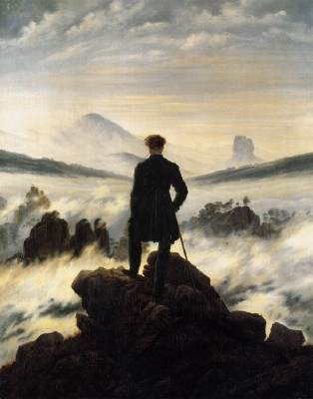
The Wanderer above the Fog, (Casper David Friedrich)
Exp. high dose
Exp. low dose

