Slide 1



Ethical Aspects of Health Surveillance: Thyroid Cancer Screening
Deborah Oughton
ISEEH, Budweis, 2016

Slide 2


Shamisen
“Medical screening raises a number of ethical issues and challenges, many of which are of direct relevance to screening and health surveillance after radiation accidents”.
Biomedical Ethics
Radiation Protection
Public Health Ethics

Slide 3
Output from Shamisen: Revision of Recommendations
Why:
  Existing focus on technical issues rather than societal, ethical, psychological, economic challenges
  Information is directed towards the decisions made by experts rather than for support of affected populations
  Changes in legal and ethical requirements (e.g., related to data protection)
  Building on lessons learnt from accidents

Slide 4
Approach
Use the recent ICRP work on ethical values and radiation protection to evaluate the Fukushima thyroid screening case...
… to support the recommendations to be produced by the Shamisen project

Slide 5
ICRP TG94: The Ethical Foundations of the ICRP System of Radiological Protection
Objective: To develop an ICRP Publication presenting the ethical foundations of the system of radiological protection.
To clarify the rationale for recommendations, to assist in implementation, identify potential conflicts and to provide a basis for communication on radiation risk.
Central focus on core values underpining the system,
5

Slide 6


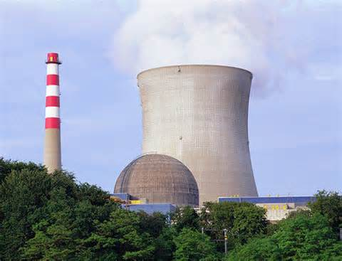
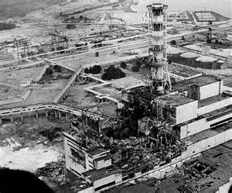

  Historical Context
Evolution of the System of Radiological Protection: Science, Ethical Values, and Experience
  Influence of scientific developments
  Influence of different applications – medical, energy, accidents, …
  Influence of changes in societal and cultural attitudes
6

Slide 7
  Core Ethical Values Underpining the System
Core ethical values underpinning the system of radiological protection
Radiological protection principles
Tools and procedures
for the practical
implementation of the system
Beneficence/Non-maleficence
Prudence
Dignity
Justice
Procedural aspects
Accountability and Transparency
Stakeholder participation
Tolerance and reasonableness
ICRP, 2016, in prep.
7

Slide 8
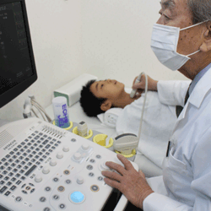
Background – Thyroid Screening
Prefecture wide screening – offered to all 18 years old and under
Baseline screening 2011-2104
  300,456 participants (81,7%)
  113 suspicious or malignant cases; 34 were operated on.
Full survey 2014-
169,455 participants (44,7%)
  25 suspicious or malignant cases; 34 were operated on
Reuters
Suzuki, 2016. Clinical Ontology; Shibuya et al. 2014, Lancet; Yasumura S, et al. Fukushima Health Management Survey, 2012;
Notes:
4365 control

Slide 9
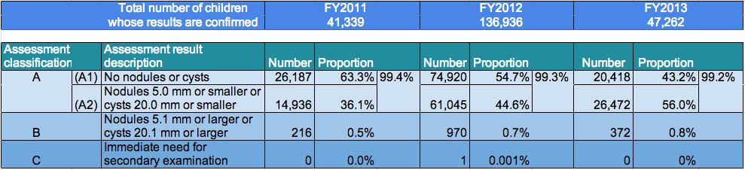
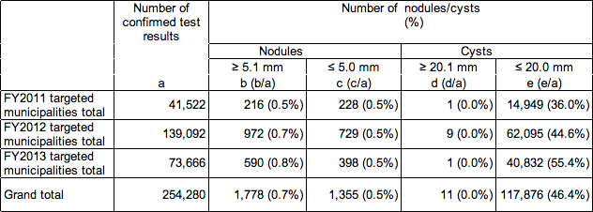
Background – Screening Results
Suzuki, 2016. Clinical Ontology; Shibuya et al. 2014, Lancet; Yasumura S, et al. Fukushima Health Management Survey, 2012;
Notes:
4365 control

Slide 10
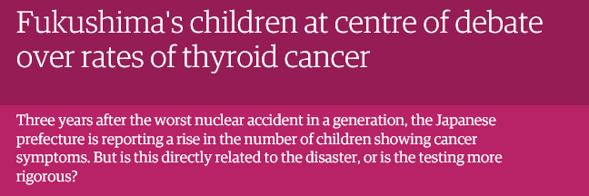
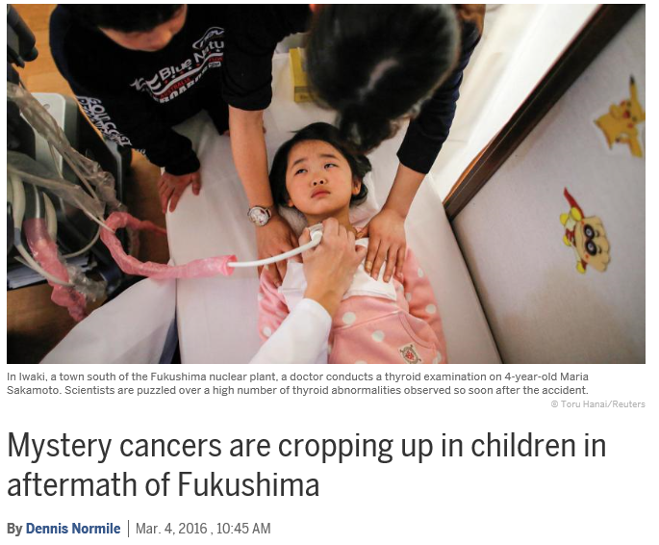


High Media and Academic Interest
Tsuda, et al. 2014: «An excess of thyroid cancer has been detected by ultrasound among children and adolescents in Fukushima Prefecture within 4 years of the release, and is unlikely to be explained by a screening surge” Epidemiology
Notes:
Toshihide Tsuda, an environmental epidemiologist at Okayama University in Japan, started presenting analyses at international conferences claiming the number of thyroid cancers in the Fukushima screening was unusually high. Last October, he published his results online in Epidemiology, concluding that the first round of screening indicated cancer incidence rates ranging from 0 to 605 cases per million kids, depending on location, but overall “an approximately 30-fold increase” over the normal childhood cancer rate. That claim fed alarming headlines.
http://www.dailymail.co.uk/news/article-3265462/Children-living-near-Fukushima-nuclear-plant-diagnosed-thyroid-cancer-rate-FIFTY-times-higher-youngsters-elsewhere.html

Slide 11
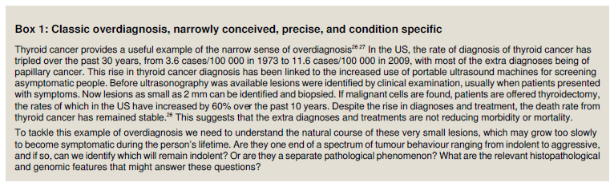
Ethics of Health Screening and Surveillance
Thyroid Screening a text book case
False positives/false negatives/overdiagnosis – unnecessary surgery or worry
Carter et al. BMJ 2015;350

Slide 12
Beneficence/Non-malificence
Are we doing more good than harm?
Will the procedure reduce incidence, severity or mortality related to the disease?
Overdiagonisis and unnecessary surgery
Relieving or increasing anxiety?
Highlights the complexity of balancing benefits and risks
“Health is a state of complete physical, mental and social well-being and not merely the absence of disease or infirmity” (WHO, 1948)

Slide 13
Prudence
“Prudence is the ability to make informed and carefully considered choices without the full knowledge of the scope and consequences of actions” ICRP in prep
Links to precautionary approach
Should not be taken to be synonymous with zero risk or over conservatism
Thyroid Screening: Careful consideration of the uncertainties and potential negative consequences of surveillance and evaluation of measures to reduce negative consequences

Slide 14
Justice
Distributive Justice - Fairness in the distribution of advantages and disadvantages among groups of people
Restorative Justice – Fairness in compensation for losses
Procedual Justice – Fairness in the rules and procedures in the processes of decision making
Recognises vulnerability of children
Selection of participants – location, not dose
Screening for reassurance, epidemiology, research …
Control groups
Participation in decision making and screening planning
Notes:
Unscear summary report: 2013; full report 2014
Effects such as depression and post-traumatic stress symptoms
have already been reported. Estimation of the occurrence and severity of such health
effects are outside the Committee’s remit.
Claims that problems grounded in the “irrational” perception of radiation risks in the public
Mean diffrerent things to diffrerent people
Frault ofr the public: irrational or phobia . Empahsis then low dose efects
Reject that these are psyclological problems, that effcts are radiation induced and treat attemts to put them down to nonradiation effrects
Irrational use ofr money – better if stopped worrying about radiation. Frocus on low benefrts ofr dose reduction
Not the dose reduction, but the incompetent way these measures wee introduced
Socio-psychological aspects complicate the evaluation of health detriments from radiation exposure.
Complicate – causality confrounder epidemiology, introduce a milutple stresor aspect (do radiation enhance or reduce effcts – low dose does not ofrfer protection from detriments bought about by social stress factors), so what in the way we deal with accident management of the possible risk assessment of radiation releases

Slide 15

Dignity
Survey (in part) responds to requests for screening from parents – recognises their autonomy
Free Informed Consent of children
Stigma and discrimination – both from participation or non-participation
Provision of information to participants, pre, during and post screening
Privacy and confidentiality issues
Notes:
Rats
Hibakusha
ETHOS Project

Slide 16
Practical Aspects
Accountability:
  Clarification on responsibilities for screening, follow-up, funding, …
Transparency
  Information to participants (initially by post, now during consultation)
  Clarity on expectations and purpose of screening
  Communication strategy, including media, public health officials
Stakeholder Participation
  Critical for success of screening
  Heath professionals, communities, parents, …
Notes:
Inequity and inequality: these terms are sometimes confused, but are not interchangeable, inequity refers to unfair, avoidable differences arising from poor governance, corruption or cultural exclusion while inequality simply refers to the uneven distribution of health or health resources as a result of genetic or other factors or the lack of resources.

Slide 17
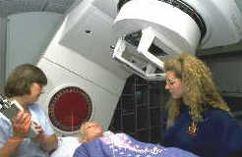
So What?
Ethical evaluation of Fukushima Case highlights the complexities and challenges of thyroid screening and strengthens the foundation for health surveillance recommendations following a nuclear accident.
Other issues to be dealt with in the report
Comparison with other cancer screening procedures
Integration with other health survellance measures in Fukushima

Slide 18
Recommendations - generic
Importance of addressing issues as part of emergency preparedness (create dialogues in «peace time»), including with media
Recognising that health surveillance is about more than the direct health impacts of radiation exposure
Ongoing involvement of stakeholders in discussions of recommendations throughout SHAMISEN

Slide 19
Designing health surveillance programmes …
Recognise and address the positive and negative consequences of health surveillance
Careful consideration of the challenges and ethical issues in thyroid screening
Engage with public health professionals and affected populations in designing health surveillance programmes
Respect autonomy, empowerment and free-choice (including privacy issues)
Identify the needs, concerns and communication requirements of different groups

Slide 20
Recommendations for improving professional support of populations
Recognise the important role of medical staff, public health practitioners, nurses, teachers, etc as communicators/interpreters
Support for training in communication skills and health literacy
Preparation of communication materials in advance
Identification and networking of key actors

Slide 21
Thank You!
Elisabeth Cardis, Gerry Thomas, Mark Pearce, Thierry Schnieder, Yevgeniya Tomkiv, Liudmila Liutsko, Bjørn Hoffman, Koichi Tanigawa, Aya Goto, Kenji Kamiya, Christiane Pölzl-Viol, An Van Nieuwenhuyse, Paola Fattibene, Ausrele Kesminiene, Sylvie Charron

