Slide 1
Energy, Economy, Ecology
Juergen Kiefer
Justus-Liebig-Universitaet
Giessen, Germany

Slide 2
…and ideology

Slide 3
Gross national product (2015) versus per capita energy consumption (2011)

Slide 4
CO₂ output vs. energy consumption

Slide 5
Economic output is closely linked to energy consumption
Energy consumption is directly related to the release of carbon dioxide (and other greenhouse gases)

Slide 6
Goals to be aimed at
Sustainability
Protection of the environment

Slide 7
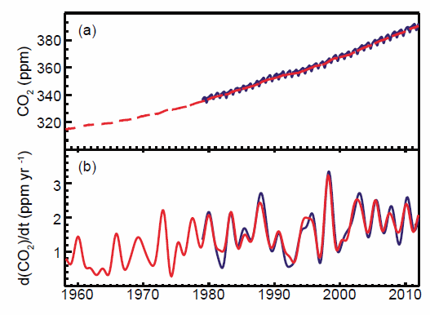
Global carbon dioxide over the years

Slide 8
Economic growth has an impact on global climate
Suggested way out of this dilemma:
Increased use of „renewable energy“

Slide 9
Renewable energy
‘energy from renewable sources’ means energy from renewable non-fossil sources, namely wind, solar, aerothermal, geothermal, hydrothermal and ocean energy, hydropower, biomass, landfill gas, sewage treatment plant gas and biogases
‘biomass’ means the biodegradable fraction of products, waste and residues from biological origin from agriculture (including vegetal and animal substances), forestry and related industries including fisheries and aquaculture, as well as the biodegradable fraction of industrial and municipal waste

Slide 10
Renewable energy sources
Wind
Hydropower
Solar energy
Biomass

Slide 11
Carbon neutrality
Under EU legislation, biomass is carbon neutral, based on the assumption that the carbon released when solid biomass is burned will be re-absorbed during tree growth,

Slide 12
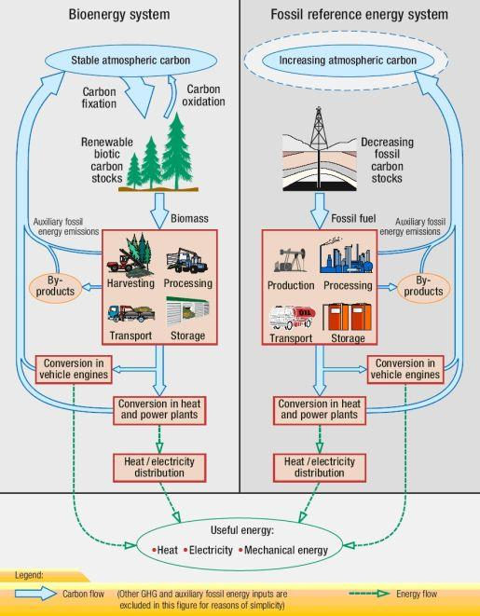
Fuel lifecycle
(International Energy Agency Task 38)

Slide 13
Consequences
CO₂-emissions due to energy production by biomass are set to zero but greenhouse gas releases during production, transport etc. are taken into account („grey energy“)¹
¹ Grey energy is the energy hidden in a product, i.e. the amount of energy required to extract that product from nature, or to cultivate, manufacture, package and transport it. Objects can conceal very different levels of grey energy: for example an apple that is grown locally or one that is shipped from from New Zealand to Europe.
(http://www.educapoles.org/multimedia/animation_detail/grey_energy_hidden_expenditure_of_energy)

Slide 14
Opinions on Carbon neutrality
The carbon in fossil fuels is different from the carbon in biomass in that fossil fuel carbon is not part of a relatively rapid natural cycle
(Recommendations on Biomass Carbon Neutrality) http://newgenerationplantations.org/multimedia/file/3229dff2-a606-11e4-9137-005056986313
World Business Council for Sustainable Development www.wbcsd.org
There are environmental issues surrounding the use of biofuels. Biodiesel naturally contains little sulfur. For example, it may be said that they are carbon neutral – the amount of carbon dioxide released when they are used is the same as the amount absorbed by the plants as they grew. If so, this would reduce the production of this greenhouse gas. However, while biofuels produce less carbon dioxide overall, they are not carbon neutral. This is because fossil fuels are used in their production, for example in making fertilisers for the growing plants.
BBC Bitesize http://www.bbc.co.uk/schools/gcsebitesize/science/aqa/crudeoil/hydrocarbonsrev3.shtml

Slide 15
Carbon neutrality – a misunderstanding
In common use „carbon neutrality“ is meant as „climate neutrality“. This is wrong as the climate does not differentiate between CO₂ from biological and that from fossil sources.
Also, carbon neutrality is only achieved under steady state conditions which are not given with increasing energy production rates.
Even with constant energy production it takes a long time (years or even decades) to reach a steady state.

Slide 16
CO₂ release by various fuels

Slide 17
Carbon neutrality?
The assumption of carbon neutrality is a theoretical construct to reduce the calculated emission figures.
Energy production by biomass does not reduce the release of greenhouse gases but leads to an increase because of the low efficiency.
Biomass burning has severe effects on the environment.
The preference for biomass production causes wrong allocations of farm land and forests.

Slide 18
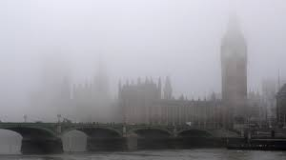
Wood burning has side effects..

Slide 19
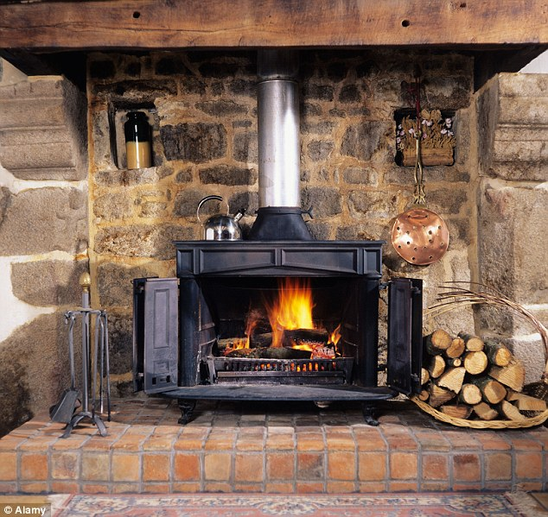
Lethal: Scientists from King’s College London say burning wood generates particulates – minuscule particles that can raise the risk of heart disease, trigger asthma and shorten lives
http://www.dailymail.co.uk/news/article-2873942/Wood-burning-stoves-fuelling-rise-winter-smog-Levels-one-form-pollution-surge-colder-months.html#ixzz4HiGOS95R

Slide 20
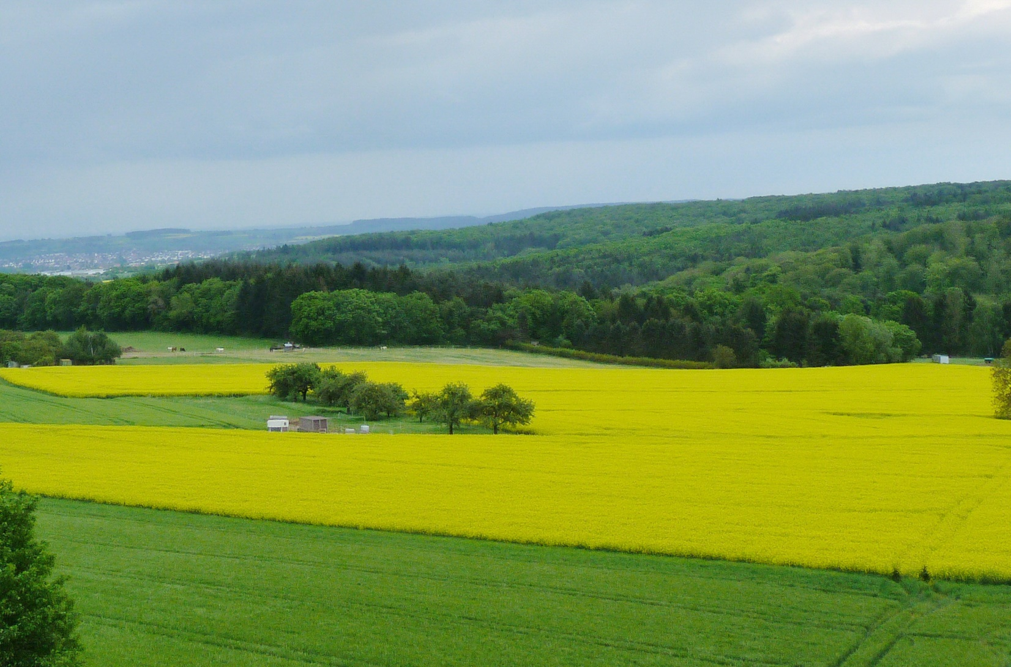
How much land is allocated to biomass production for energy?

Slide 21
Climate neutrality of biomass is a myth, may be a fake

Slide 22
The nuclear option?
Nuclear energy does not produce greenhouse gases but „grey energy“ has to be taken into account.
BUT:
There is great concern about the real possibility of nuclear disasters.
The waste problem is so far not resolved.
Nevertheless the nuclear option has still to be considered. Science and technology should concentrate on the solution of the problems.

Slide 23
Conclusions
Economical welfare is linked to the provision of energy.
Energy production must be sustainable and also not hazardous for the climate.
„Recoverable“ energy sources can only partly meet these conditions.
„Biomass“ use may be „carbon neutral“ but it is definitely not „climate neutral“.
Nuclear energy is still an option, it should be developed to a state of more safety and a substantial reduction of waste.

Slide 24
Ethical implications
It is an ethical obligation to provide at least acceptable living conditions for THE WHOLE of mankind (not only for a „lucky part“). This is not possible without the provision of energy. At the same time the world climate has to be protected. To reach both goals at the same time seems presently not possible. Solutions have to be approached with the best scientific methods available – without political and ideological prejudices.

Slide 25
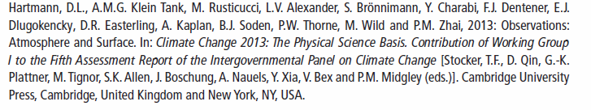
Hartmann, DL et al. (2013)

