Slide 1
Discourses on risks and discourses on values in environmental health
Michielkorthals@gmail.com

Slide 2
Environmental health, justice & good life
Agriculture and food production as issues of environmental health
  GM, obesity, air pollution, Q-fever
Distribution: justice
Production: quality, good life, values
Long term risks
Long term value changes: landscape, social-economic organization etc

Slide 3
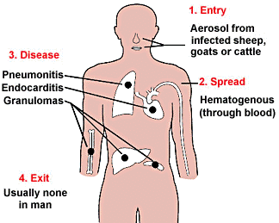

Slide 4
Content
Dominant political discourse on environment and technologies: numerical assessment of consequences by experts
Concerns of citizens: values (often: long term changes)
Talking at cross purposes
Pulling values out assumptions of risks analysis: Examples from food and agricultural technologies
    Genetic modification of crops
      Experts: Risks and Natural
      Citizens: Unnatural means increasing an uncontrollable food industry with a monopoly on crops and food, etc
    Intensive pig farming
      Experts: risks and high tech
      Citizens: values of animals
Value discourses

Slide 5
Dominant discourse: risk analysis
What can happen? (i.e., what can go wrong?): Exposure
How likely is it that it will happen? Probability
If it does happen, what are the consequences?
Risk is the sum of the products of the consequences multiplied by their probabilities.
Dominant: quantative analysis of disease burden
Comparing risks: GM with bicycling or driving
Risk communication of information: understanding or misunderstanding
Don’t motivate to act; no intrinsic motivation to realize a certain state

Slide 6
No risks analysis without value assumptions
Technology: assumed as neutral
Technology: take it or leave it: no transforming of t
Not neutral: mostly hedonistic, materialistic losses
Consequentialistic: something is right when the good consequences outweigh the bad one
Framing the issue

Slide 7
Citizens’ (and experts’) values
About what people strive for: not what they don’t want
Values motivate to act
Opposite values: connected with different lifestories
Not quantitative; life experiences
Values need practices: experiences, friendship, solidarity, empathy, stories, practices
Values and risks analysis: often collusion between framework and content

Slide 8
Talking at cross purposes: disrespect from both sides
Confrontation of risks and values
Risk position to value positon: ‘all misunderstandings’: risk as information
Risk position to value position: ‘romantic’; ‘nostalgia’; collusion of worldviews
Value position to risk position: Frankenstein; corruption; everything for sale; downgrading farmers to employers

Slide 9
Genetic modification of crops
Technologists: health and environmental risks are nihil
To citizens: your worries are senseless
Assumption of technologists: citizens believe that this technology is ‘unnatural’, and consequently they show that it is very natural and therefore with minimal risks.
Or they device new gm technologies like cisgenesis
Environmental risks: Darwinian evolution: resistance of pests (10)
More use of chemicals than before GM

Slide 10
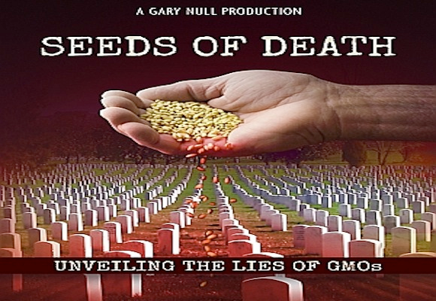
Opponents
Seeds of death: unveiling the lies of GMOs, en Horrific new studies in GMOs, you're eating this stuff!! en They are killing us—GMO foods.
Greenpeace: environmental risks (e.g. decline of biodiversity);
Concept of unnatural covers many (normative) meanings
Better way of dealing with environment and nature
Fear for uncontrollable food industry with a monopoly on crops and food
Homogenization of four standard crops (maize, wheat, potato rice)
Patents as monopoly

Slide 11
Framing agriculture with GM
Seed oriented
Value question: what is the practice of agriculture?
Ecosystem oriented

Slide 12
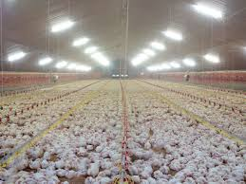
Environmental health and intensive farming
Fine particles, methane etc harm human health
Risks, comparison with other fine particles sources
Solution: intensive pig farming with air brushing, water cleaning etc
No limit to number of animals
Value: it is right to treat animals this way?

Slide 13
possible clashes
Clash between risks and values as between apples and pears
Clash with respect to policy impacts
Clash by denying any impacts (result of framing issues)
Clash by using different technology concepts: neutral versus value laden

Slide 14
Deliberation about values
Pluralism and relativism
Overlapping consensus on certain values
Agreeing to disagree
Narratively finding out what the good, the aim is of a practice

Slide 15
Integrative assessment of risks and policies
Integration of disciplines
Integration of stakeholders values and frames
Process oriented, long term
Sometimes: first value discussion than risk analysis

Slide 16
Literature
Briggs, David J., 2008, A framework for integrated environmental health impact assessment of systemic risks. Environmental Health 7:61 doi:10.1186/1476-069X-7-61

